Slide 1
Problems 6,7,8,9,12,22

Slide 2
Chapter 7 -1-2
When all the elements in A are the same, notice that the comparison in line 4 of PARTITION is always satisfied and i therefore is incremented in each iteration. Since initially i ← p - 1 and i + 1 is returned, the returned value is r - 1.
To make PARTITION return (p + r)=2 when all elements are the same, simply modify the algorithm to check for this case explicitly.

Slide 3
7.1.3 & 7.1.4
The running time of PARTITION is (n) since each iteration of the for loop involves a constant number of operations and there is (n) iterations in total.
To make QUICKSORT sort in nonincreasing order replace the <= comparison in PARTITION line 4 with >=.

Slide 4
7.2.2
If the elements in A are the same, then by exercise 7-1 - 2 the returned element from each call to PARTITION(A, p, r) is r - 1 thus yielding the worst-case partitioning. The total running time is easily seen to be (n²).
The recurrence in this case is
T(n) = T(n – 1) + Θ(n)
= T(n – 2) + Θ(n – 1) + Θ(n)
= T(n – 3) + Θ(n – 2) + Θ(n – 1) + Θ(n) …
= Θ(n) + Θ( n²) = Θ(n²)

Slide 5
7.2.3 & 7.2.4
(3)If the elements in A are distinct and sorted in decreasing order then, as in the previous exercise,we have worst-case partitioning. The running time is again (n2).
(4) As the data being sorted becomes closer to sorted, insertion sort gets closer to Θ(n) and quicksort gets closer to Θ(n2). Therefore, there comes a point at which insertion sort performs better than quicksort. Further, while quicksort is still Θ(n lg n) the constant multiple continues to grow as the data is more sorted. And with insertion sort, the constant multiple continues to shrink.

Slide 6
7.2.5
log_{1/α}n = (log_{b}n)/(log_{b}1/α) = –(log_{b}n)/(log_{b}α) = –(lgn)/(lgα)
log1/(1-α)n = (logbn)/(logb1/(1-α)) = –(logbn)/(logb(1-α)) = –(lgn)/(lg(1-α))

Slide 7



7.1
A =
13 19 9 5 12 8 7 4 11 2 6 21
i j ⇐ j
6 19 9 5 12 8 7 4 11 2 13 21
i ⇒ i j ⇐ j
6 2 9 5 12 8 7 4 11 19 13 21
i ⇒ …………………………⇒ ⇐ j
return 11, SPLIT = and

Slide 8
7.1
i cannot go past j more than 1 index.
j cannot go off the end of the array, because …
(case 1) it will stop at the pivot at the end of the array, or
(case 2) it will stop when it reaches i.
i cannot go past j if j is at its first element.
j will have at least two chances to move before i can get to j, since i stops at the first index (where the pivot element is).

Slide 9
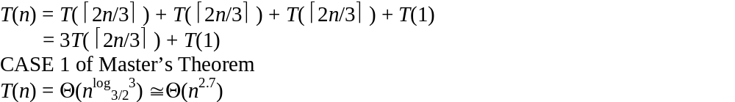
7.3
The array is sorted in place and the size of the array being sorted is always brought down to two elements (recursively). Each set of two elements in a row is recursively compared and swapped if necessary. Therefore the array will be sorted.
No. The running time of STOOGE-SORT is always worse than insertion sort, merge sort, heapsort, and quicksort.

Slide 10
7.4
a. Clearly, the QUICKSORT' does exactly the same as the original QUICKSORT and therefore works correctly.
Worst-case partitioning can cause the stack depth of QUICKSORT' to be Θ(n) . Because the array is already ordered.
If we recursively call QUICKSORT' on the smallest subarray returned by PARTITION we will avoid the problem and retain a O(lg n) bound on the stack depth.

Slide 11
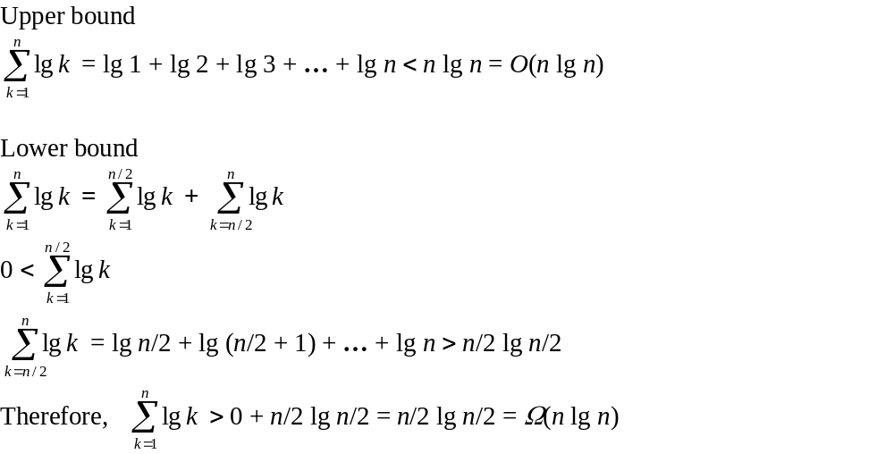
8.1.1 & 8.1.2
n – 1

Slide 12
9.1.3
Since the depth of a decision tree is lg n!, it takes at least that many comparisons.
lg n!/2 = lg n! – lg 2 = lg n! – 1 = Θ(n lg n)
Therefore, there is no comparison sort whose running time is linear on at least ½ of n! inputs of length n.
lg n!/2n = lg n! – lg 2n = lg n! – n = Θ(n lg n) – Θ(n) = Θ(n lg n)
Therefore, there is no comparison sort whose running time is linear on at least 1/2n of n! inputs of length n.

Slide 13
Example
Prove that 2n – 1 comparisons are necessary in the worst case to merge two sorted lists containing n elements each.
Since the arrays are sorted, once the highest element of array A is found to be lower than an element of array B, all the following elements of B can be directly inserted into array C. So the worst case is when all elements are compared. This happens when the values A[i] ≤ B[i] ≤ A[i + 1] ≤ B[i + 1] ≤ … ≤ B[n]. In this case, each element (except the first and last) is compared to two other elements.

Slide 14
Example
Professor Solomon claims that the Ω(n lg n) lower bound for sorting n numbers does not apply to his computer environment, in which the control flow of a program can split three ways after a single comparison ai : aj, according to whether ai < aj, ai = aj, or ai > aj. Show that the professor is wrong by proving that the number of three-way comparisons required to sort n element is still Ω(n lg n).
The minimum height of a decision tree split three ways is log3 n!
log3 n! = lg n! – lg 3 = c lg n! = Θ(n lg n)
Lower bound = Ω(n lg n)

Slide 15
8.1.4

Slide 16
8.2.3 & 8.2.4
COUNTING-SORT will work correctly no matter what order A is processed in, however it is not stable. The modification to the for loop actually causes numbers with the same value to appear in reverse order in the output. This can seen by running a few examples.
Given n integers from 1 to k show how to count the number of elements from a to b in O(1) time with O(n + k) pre-processing time. As shown in COUNTING-SORT we can produce an array C such that C[i] contains the number of elements less than or equal to i. Clearly, C[b] - C[a] gives the desired answer.

Slide 17
8.3.2
Insertion sort is stable.
Quicksort is not stable.
Merge sort is stable.
If two elements are equal, then sort them based on their previous order.

Slide 18
8.3.3
Base case:
In a single column of elements, the column will be sorted.
Inductive Hypothesis:
Assume that each column up to column d – 1 in a d-column set is sorted.
Prove for column d:
Let c = d – 1
By the inductive hypothesis, a c-column set will be sorted. Since c and d are simply variables, a d-column set will also be sorted.
The assumption of a stable sort is made in the inductive hypothesis.

Slide 19
8.3.4
Put the integers into the range of [0, 1) by dividing each by (n² + 1). Then use bucket-sort to sort the set. Then multiply each number by (n² + 1) to get back to the original integer values.
Show how to sort n integers in the range 0 to n² - 1 in O(n) time. Notice that the number of digits used to represent an n² different numbers in a k-ary number system is d = log_{k}(n²). Thus considering the n² numbers as radix n numbers gives us that:
d = log_{n}(n²) = 2 log_{n}(n) = 2
Radix sort will then have a running time of Θ (n + k) = Θ(2(n + n)) = Θ(n).

Slide 20
8.4.2
The worst-case running time for bucket-sort is O(n²). This will happen if all elements happen to be placed in the same bucket and any O(n²) sort (such as insertion sort) is used to sort the buckets.
By using Merge sort to sort the buckets the worst-case becomes O(n lg n).

Slide 21
9.1.1
To find the smallest element construct a tournament as follows: Compare all the numbers in pairs.
Only the smallest number of each pair is potentially the smallest of all so the problem is reduced to size n/2 . Continuing in this fashion until there is only one left clearly solves the problem.
Exactly n - 1 comparisons are needed since the tournament can be drawn as an n-leaf binary tree which has n - 1 internal nodes (show by induction on n). Each of these nodes correspond to a comparison.
We can use this binary tree to also locate the second smallest number. The path from the root to the smallest element (of height lg n) must contain the second smallest element. Conducting a tournament among these uses lg n - 1 comparisons.
The total number of comparisons are: n - 1 + lg n - 1 = n + lg n - 2.

Slide 22
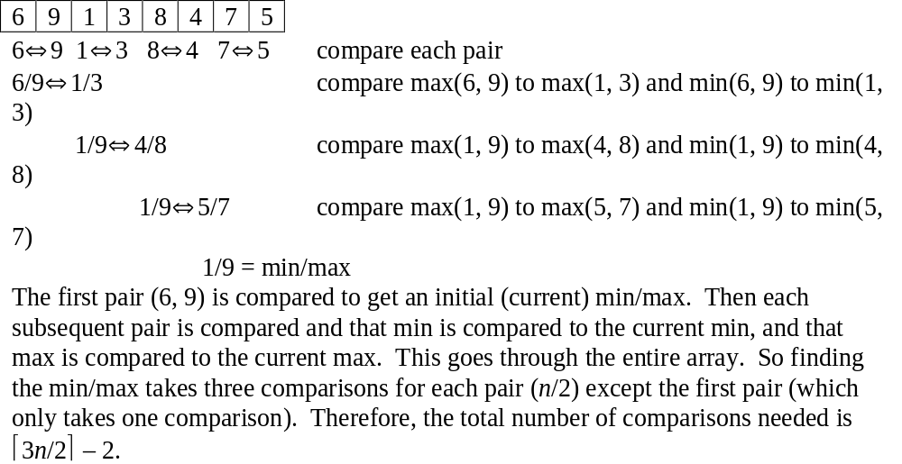
9.1.2

Slide 23
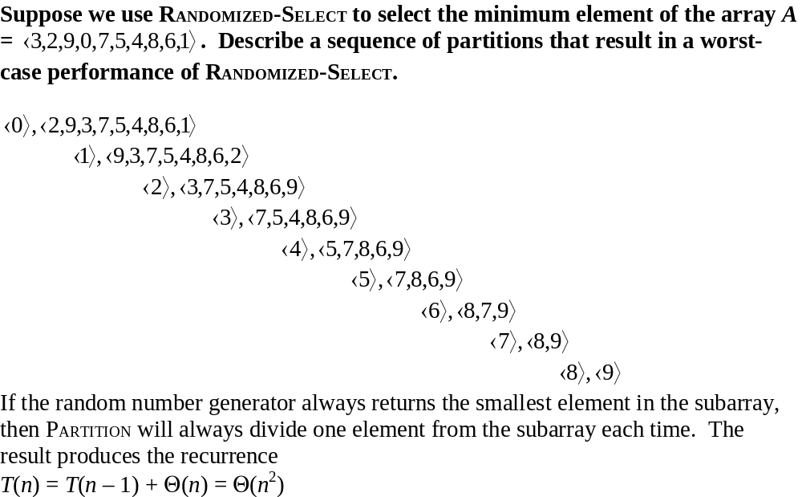
9.2.4

Slide 24
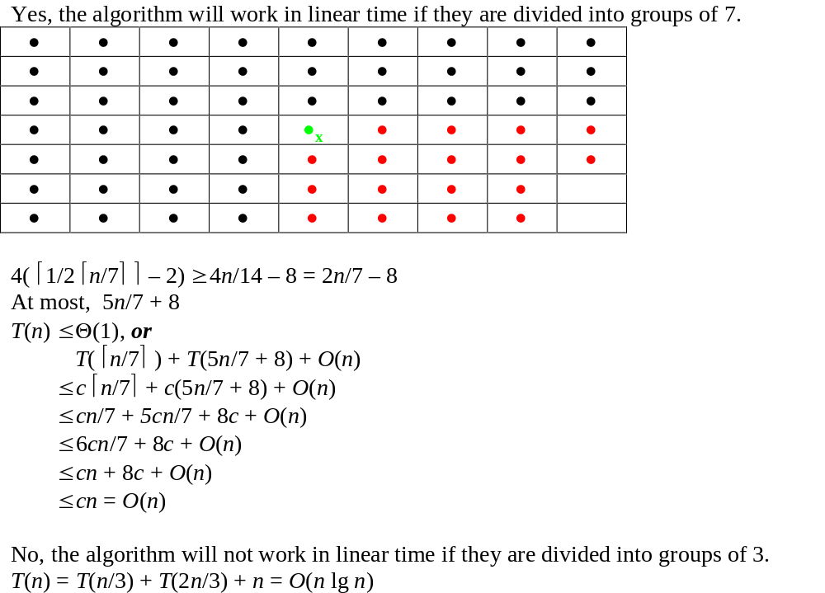
9.3.1

Slide 25
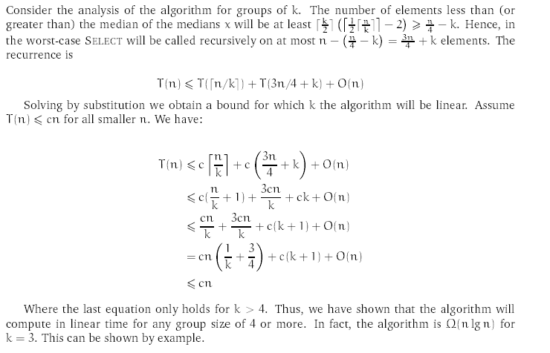
9.3.1

Slide 26
9.3.3
Quicksort can be made to run in O(n lg n) time worst-case by noticing that we can perform perfect partitioning: Simply use the linear time select to nd the median and perform the partitioning around it. This clearly achieves the bound.
Use the SELECT procedure to find the median-of-medians and use this element as the partitioning element. This will ensure that the split is always good enough to avoid the possibility of a O(n2) worst-case split.

Slide 27
9.3.4
Since the SELECT procedure partitions the array around the ith smallest element, the entire array has already been divided such that all elements that are greater than the ith element are in one sub array and all others are in a sub array with the ith smallest element. Further, the ith smallest element will be the first element in its sub array, because it was the partitioning element.

Slide 28
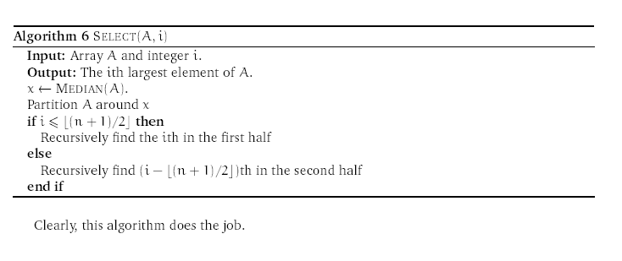
9.3.5

Slide 29
10.1
a. Sort the numbers and list the i largest.
Use Merge sort to sort the elements, then list the last i elements in the sorted array: Θ(n lg n) + i = Θ(n lg n)

Slide 30
12.1.2
The definitions clearly differ. If the heap property allowed the elements to be printed in sorted order in time O(n) we would have an O(n) time comparison sorting algorithm since BUILD-HEAP takes O(n) time. This, however, is impossible since we know (n lg n) is a lower bound for sorting.

Slide 31
12.1.3
ptr = root
push ptr->element
while ptr->left ≠ NIL
ptr = ptr->left
push ptr->element
pop element
if stack is not empty
ptr = top_of_stack
pop element
else if ptr->right ≠ NIL
ptr = ptr->right
push ptr->element
else
return
repeat

Slide 32
12.1.4
PREORDER–TREE–WALK(x)
if x ≠ NIL
then print key[x]
PREORDER–TREE–WALK(left[x])
PREORDER–TREE–WALK(right[x])
POSTORDER–TREE–WALK(x)
if x ≠ NIL
then POSTORDER–TREE–WALK(left[x])
POSTORDER–TREE–WALK(right[x])
print key[x]

Slide 33
12.1.5
Since each element must be compared down one branch of the tree whose height is ≥ Ω(lg n), the time to construct the tree is ≥ n * Ω(lg n) = Ω(n lg n).

Slide 34
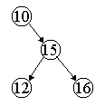
12.2.4
12 is not less than 10, but it is left of the path to 16.

Slide 35
12.2.5
Show that if a node in a binary search tree has two children then its successor has no left child and its predecessor has no right child.
Let v be a node with two children. The nodes that immidiately precede v must be in the left subtree and the nodes that immidiately follow v must be in the right subtree. Thus the successor s must be in the right subtree and s will be the next node from v in an inorder walk. Therefore s cannot have a left child since this child since this would come before s in the inorder walk. Similarly, the predecessor has no right child.

Slide 36
12.2.7
Since the minimum element in a tree is then left-most node, the worst-case is if the tree is built by inserting elements in decreasing order so that it is a left-going list. In this situation TREE-MINIMUM must traverse the entire tree, which happens in Θ(n)-time. However, in the average (and best) case the height of the tree is Θ(lg n), so TREE-MINIMUM will run in Θ(lg n)-time.
TREESUCCESSOR processes each subtree before proceeding to the next subtree outside the current one. Therefore, it has to traverse each edge no more than twice.
2n = O(n)
O(n) + O(n) = O(n)

Slide 37
12.2.9
If x is a leaf node, then if p[x] = y and x is the left child then running TREE-SUCCESSOR yields y. Similarly if x is the right child then running TREE-PREDECESSOR yields y.

Slide 38
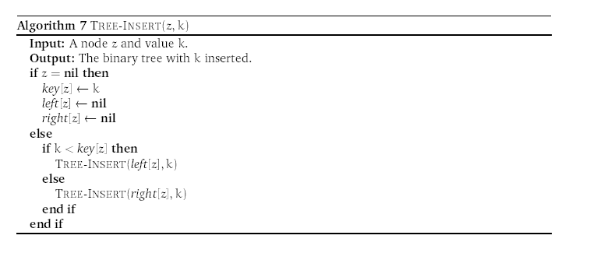
12.3.1

Slide 39
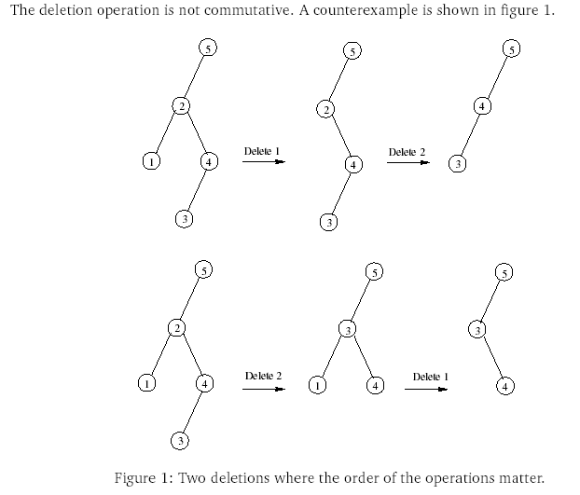
12.3.5

Slide 40
12.3.6
Keep a flag in the delete function that tells it whether it swapped the successor of predecessor in the last deletion involving either, and the next time delete is called on a deletion involving either of these, use the opposite one and change the flag.

Slide 41
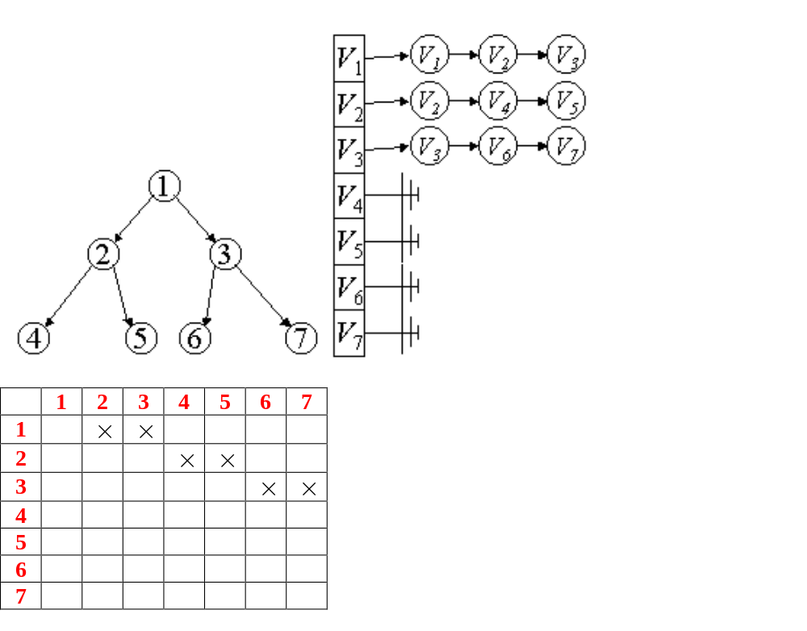
22.1.1 & 22.1.2
O( V+E )

Slide 42
22.1.3
The transpose of a directed graph G^{T} can be computed as follows: If the graph is represented by an adjacency-matrix A simply compute the transpose of the matrix AT in time O(V²). If the graph is represented by an adjacency-list a single scan through this list is sufcient to construct the transpose. The time used is O(E + V).
The square of a graph can be computed as follows: If the graph is represented as an adjacency matrix: A simply compute the product A² where multiplication and addition is exchanged by anding and oring. Using the trivial algorithm yields a running time of O(n³). Using Strassens algorithm improves the bound to O(nlg 7) = O(n^{2.81}).
If we are using the adjacency-list representation we can simply append lists eliminating duplicates. Assuming the lists are sorted we can proceed as follows: For each node v in some list replace the v with Adj[v] and merge this into the list. Each list can be at most V long and therefore each merge operation takes at most O(V) time. Thus the total running time is O((E+V)V) = O(E+V²).

Slide 43
22.1.6
Keep auxiliary data for each vertex, which is in-degree and out-degree. Then search each vertex for n – 1 and 0, respectively. O(V)

